Slide 1


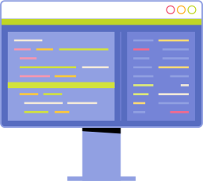

Text Analysis with Spacy
NLP Workshop
By Nirmal Rampersand
By Nirmal Rampersand

Slide 2
Python Programming Course
Nirmal Rampersand Lead Software Engineer
at Unrism
Full Stack Web Development
API Development
Artificial Intelligence & Machine Learning
Natural Language Processing
Computer Vision
Computational Intelligence & Optimisation
By Nirmal Rampersand

Slide 3
What is Spacy?
NLP Workshop
Spacy is Natural Language Processing Library
By Nirmal Rampersand

Slide 4
NLP Workshop
Natural Language Processing
Subset of Artificial Intelligence (AI)
Enables computers to understand human language (text and speech)
Computational linguistics
rule-based matching
statistical analysis
machine learning or deep learning models
to comprehend the human language
Natural language analysed, quantified, understood, and derived meaning(context)
By Nirmal Rampersand

Slide 5
Applications of NLP
NLP Workshop
Applications
Recent Developments
text analysis and classification
sentiment analysis
automatic summarisation
chatbots
speech recognition
translation
predictive text
ChatGPT
Developed by OpenAI
one of the most advanced natural language models
By Nirmal Rampersand
Notes:
Variables can start with an underscore ( _ ) character for different access rules (private/protected). Example: _name

Slide 6
NLP Workshop
Spacy
NLP library
Support for over 72 languages
offers pre-trained models
allows named-entity recognition, part-of-speech tagging, dependency parsing, sentence segmentation, lemmatisation, morphological analysis, etc
has built-in visualiser (displacy)
support for custom pipelines (tokenisation, tagging, parsing, ner, …)
efficient library (memory usage)
By Nirmal Rampersand

Slide 7
NLP Workshop
Text Analysis
Sentence Segmentation
Tokenisation
POS Tagging
Named entity recognition
Stop word removal
Lemmatisation
Word frequency analysis and word cloud generation
Dependency visualisation
Concept analysis
By Nirmal Rampersand

Slide 8
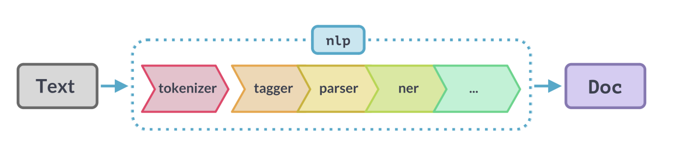
NLP Workshop
Spacy Language Processing Pipeline
By Nirmal Rampersand

Slide 9
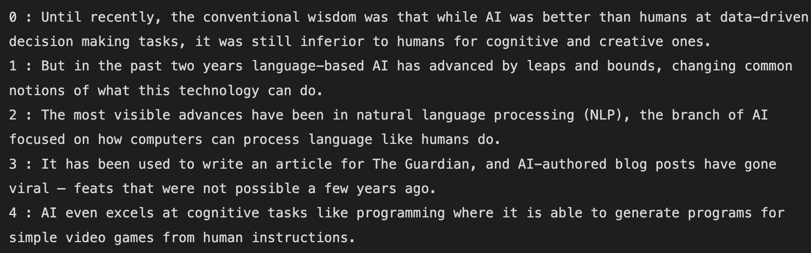
NLP Workshop
Sentence Segmentation
Sometimes we have big chunks of text consisting of multiple sentences or paragraphs
For text analysis, we need to split the text apart into separate sentences
Often considered as preprocessing
By Nirmal Rampersand

Slide 10
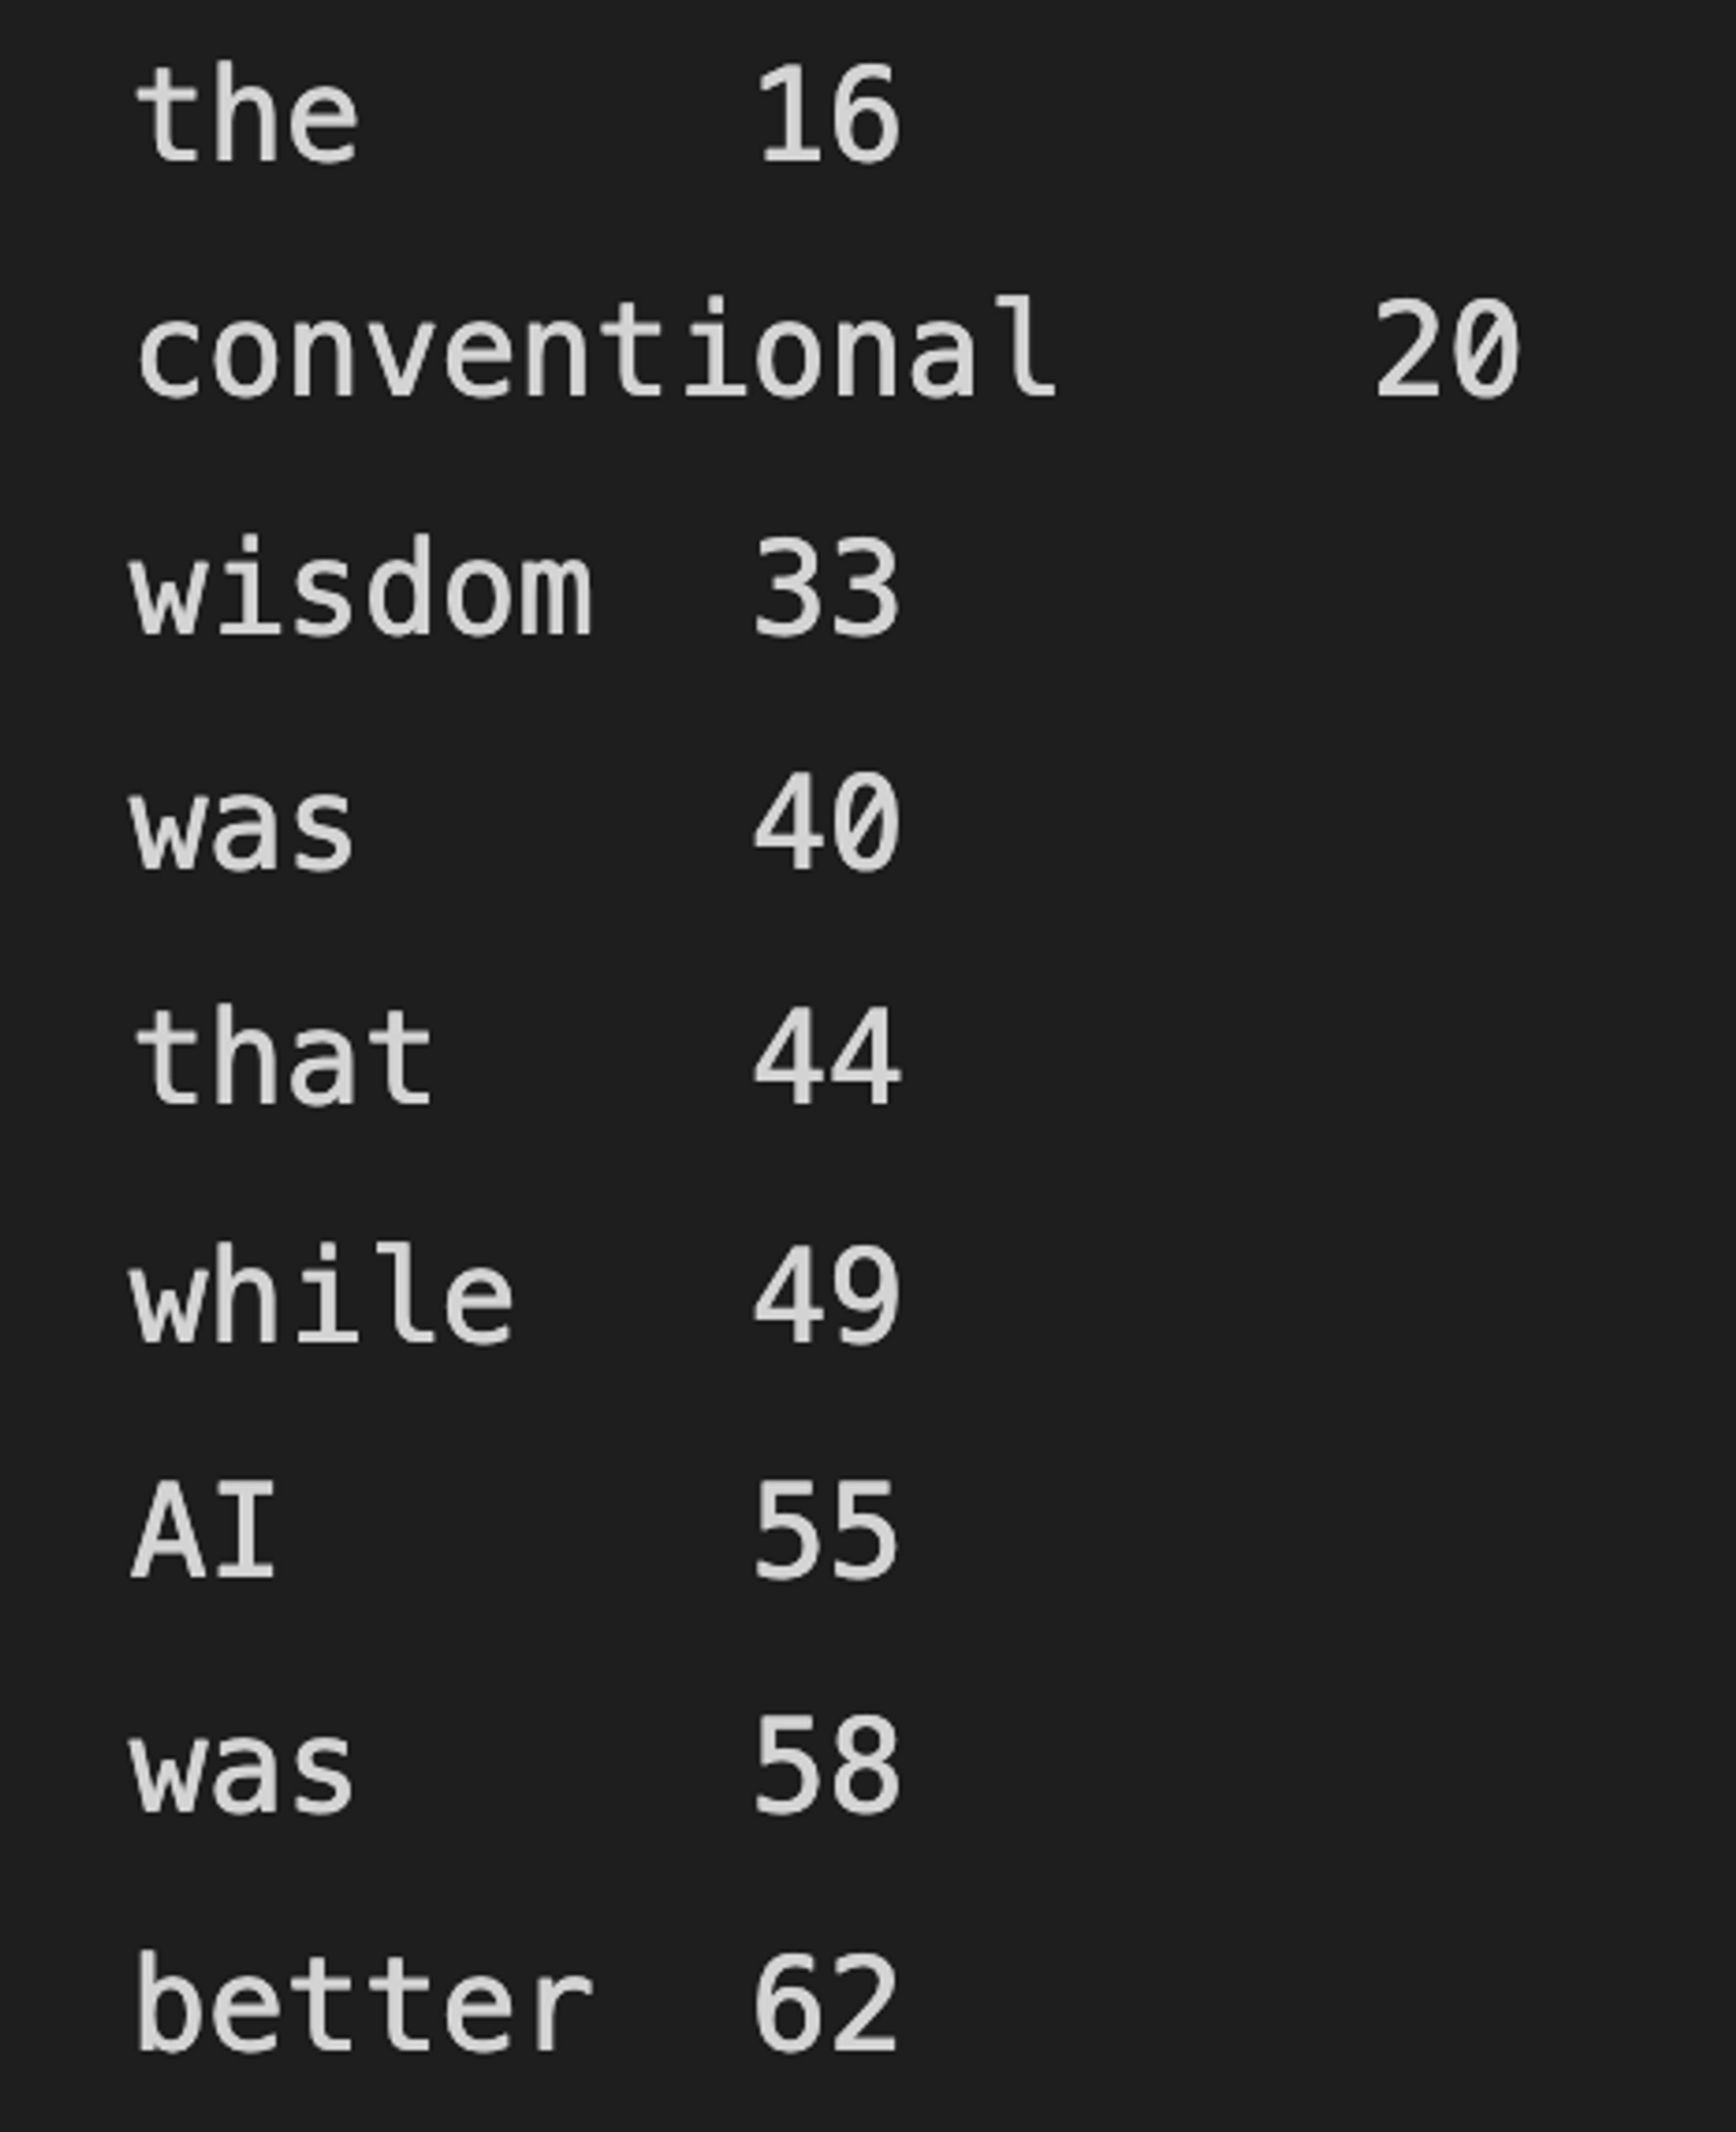
NLP Workshop
Tokenisation
First step in most NLP pipelines
Splits text into discrete elements (words and punctuation)
A token can be a word, punctuation, verb, noun, etc
By Nirmal Rampersand

Slide 11
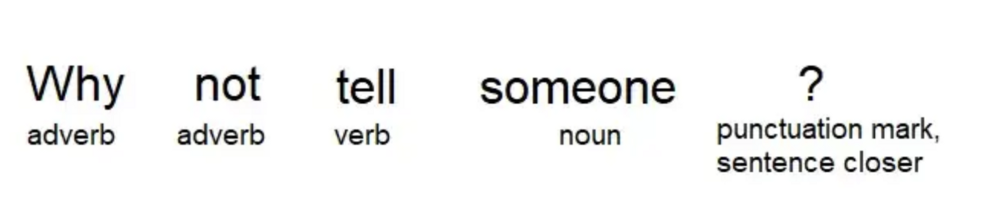
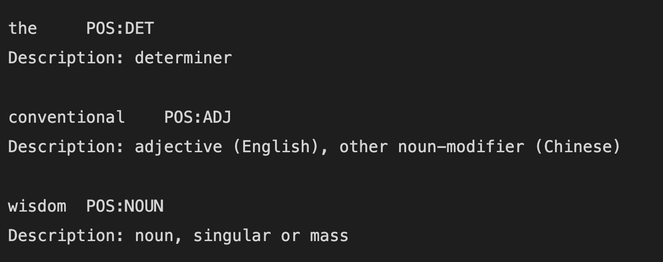
NLP Workshop
Part-of-speech tagging
process of categorising words depending on
definition of word
Context
POS tags are encoded into shorter form by spacy
used to understand the context and meaning of the word in a sentence
By Nirmal Rampersand

Slide 12
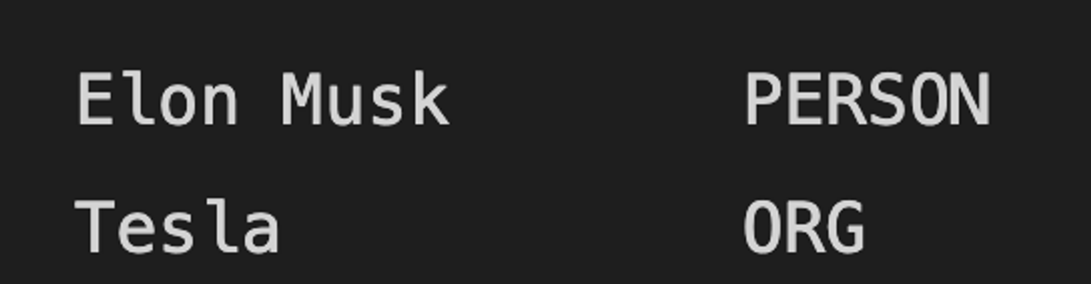
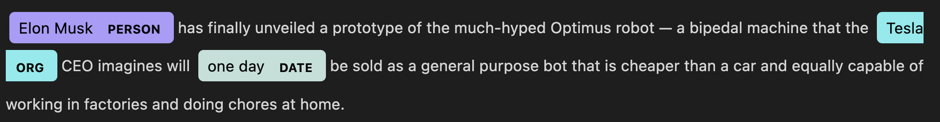
NLP Workshop
Named Entity Recognition (NER)
A named-entity is a “real-life object” such as a person, a organisation, a location, a time or a product
NER is the process of predicting and identifying named entities
By Nirmal Rampersand

Slide 13
NLP Workshop
Stop word removal
process of removing stop words so that stop words do not hinder other processes such as frequency analysis
Stop words are the most common words in a language that are not significant in a sentence
Examples: a, the, are, but
By Nirmal Rampersand

Slide 14
NLP Workshop
Removing punctuation and stripping
Stripping the tokens will remove empty spaces
Removing punctuation will remove punctuation symbols such as (. , -)
By Nirmal Rampersand

Slide 15
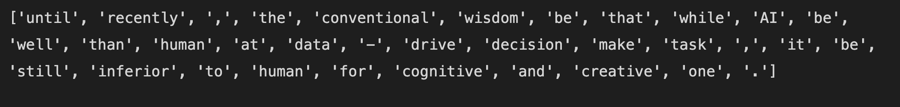
NLP Workshop
Lemmatisation
process of reducing a word to its base word (root)
the base word(root) is called the lemma
for example: For eats, ate, eating , the lemma is eat
Helps in normalising text
By Nirmal Rampersand

Slide 16
NLP Workshop
Dependencies
process of extracting the dependency graph of a sentence
to represent its grammatical structure
defines the dependency relationship between headwords and their dependents
Graph can be explained as follows:
words/tokens are nodes
dependencies are edges (relationships/arrows)
By Nirmal Rampersand

Slide 17
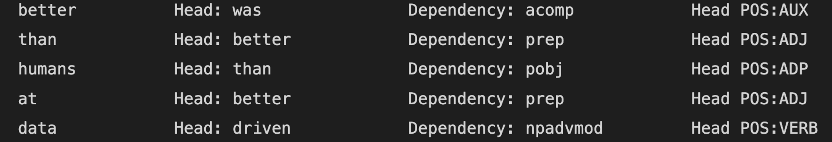
NLP Workshop
Dependencies
By Nirmal Rampersand

Slide 18
NLP Workshop
Word Frequency Analysis
The number of times a word appears can be analysed
The Counter library can be used for that purpose
By Nirmal Rampersand

Slide 19
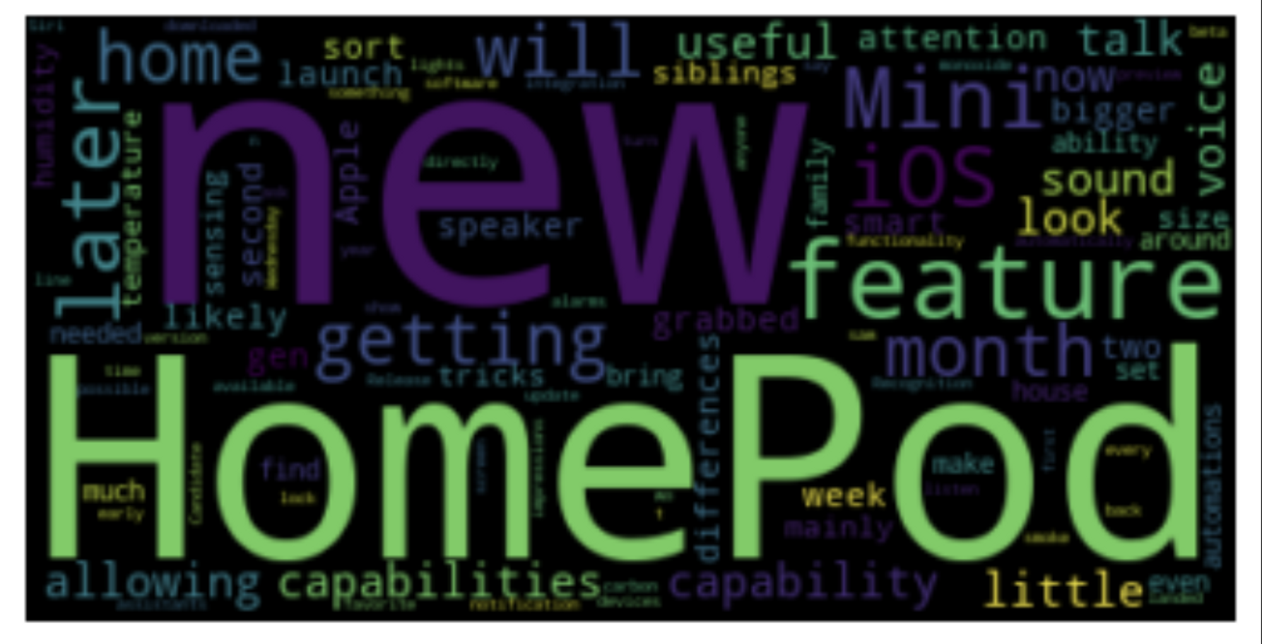
NLP Workshop
Freq Analysis with WordCloud
data visualisation technique
represents text frequency and importance
bigger words have higher frequency
By Nirmal Rampersand

Slide 20
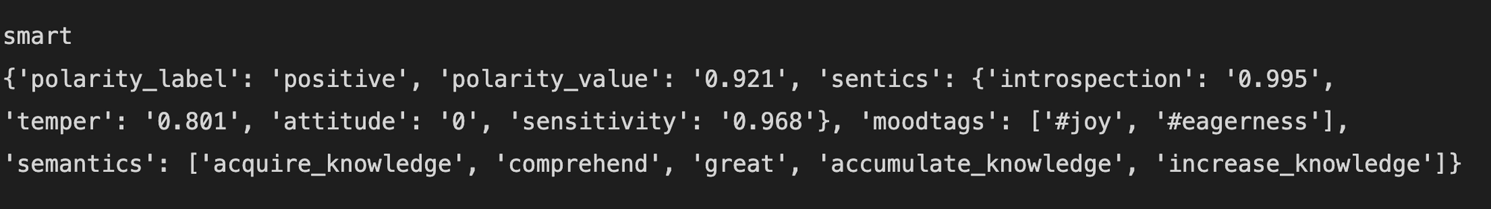
NLP Workshop
Bonus: Concept Analysis
pre-trained model
concept-based
sentiment prediction
By Nirmal Rampersand

Slide 21
NLP Workshop
Bonus: Multi-processing pipelines
Spacy allows multiprocessing
More than 1 process can be spawned at a time
It is inefficient for small datasets but far more useful on large datasets with large batches
By Nirmal Rampersand

Slide 22
NLP Workshop
< Hands-on Demo>
By Nirmal Rampersand

Slide 23
NLP Workshop
< Thank you >
For your attention
By Nirmal Rampersand

